Slide 1
Recitation 5
CNN: Basics and Backprop
Instructors:
Schadrack Niyibizi
R Raghav
29th Sep 2023

Slide 2
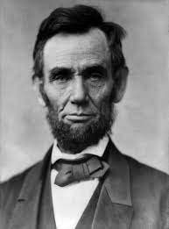
What is an image?
A visual representation

Slide 3
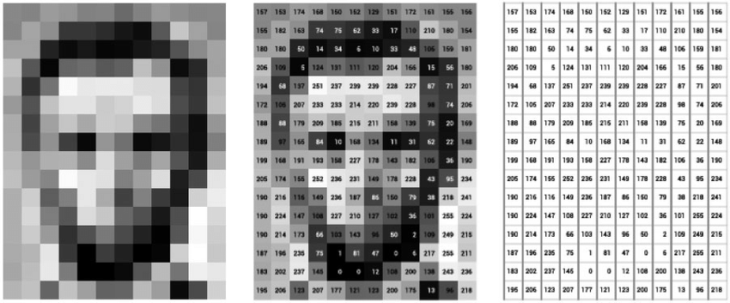
What is an image? : For a computer!
A visual representation. A Matrix I of dimensions (M,N)with I[i][j] = intensity(pixel(i,j))

Slide 4
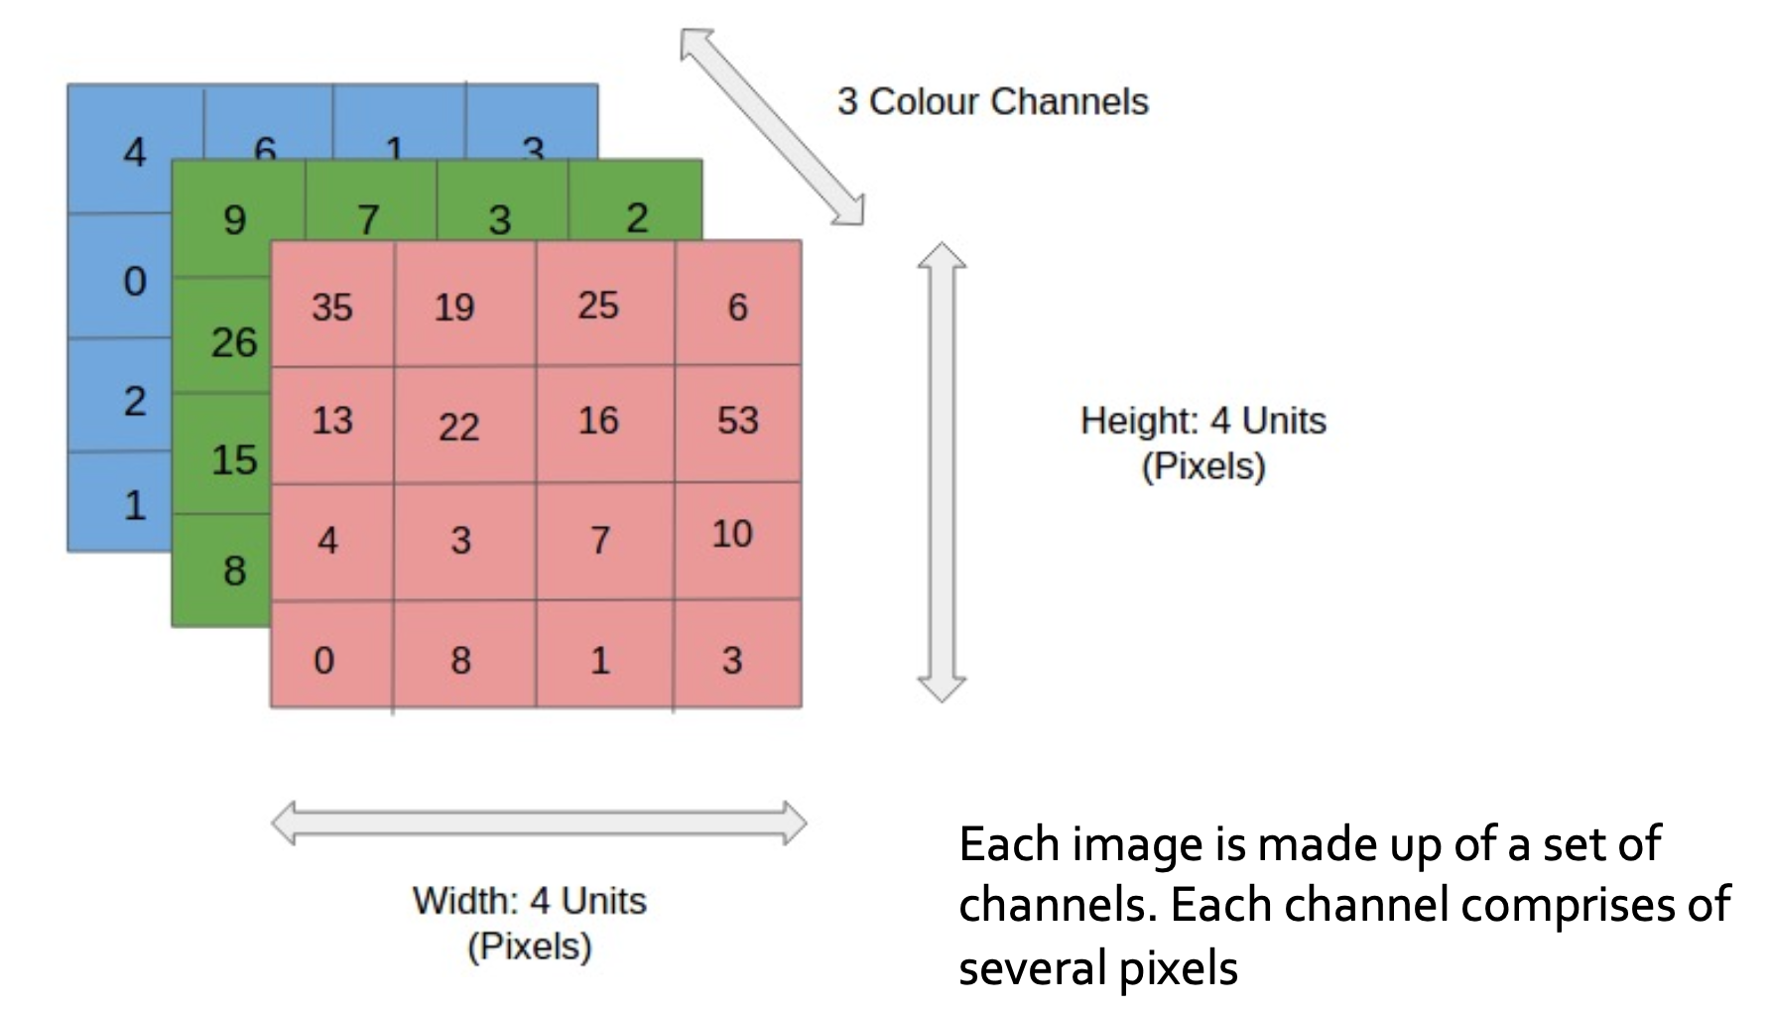
What is an image?
I → (3,M,N)
I[c][i][j] =
Intensity at pixel(i,j) for channel c
3 for a colored image, 2 for B&W.
The number of channels you encounter could even increase!

Slide 5
CNN
A CNN is a specialized neural network which employs convolutional and pooling layers to extract features and hierarchical patterns automatically from the input. It's widely used in tasks like image recognition and object detection due to its ability to learn and recognize complex visual patterns.

Slide 6
MLP Vs. CNN
Vector to Vector
Feature map to Feature map

Slide 7
Building Blocks of a CNN
Main Building blocks
Convolution Layer
Pooling Layer
Others(can also be found in MLP)
Activation Layer
Normalization Layer(LayerNorm, etc)
Batch Normalization (BatchNorm)
Notes:
: Basically a collection of weights that can be applied to an image so that the area where a pattern is located gets more emphasis. How? (Wait for next slide)
The amount by which the filter/kernel moves. If stride is 1, the filter will move by 1 pixel dimension.
[[(width/height) - kernel size * 2 + padding)/stride +1]
: Number of filters applied
: The number of channels in the input

Slide 8
Building Blocks of a CNN
Hyperparameters
Conv layer:
Filter/kernel size
Stride
# of filters,
Padding
Pooling layer:
Pooling type & size(pool size)
Stride
# of layers
Notes:
: Basically a collection of weights that can be applied to an image so that the area where a pattern is located gets more emphasis. How? (Wait for next slide)
The amount by which the filter/kernel moves. If stride is 1, the filter will move by 1 pixel dimension.
[[(width/height) - kernel size * 2 + padding)/stride +1]
: Number of filters applied
: The number of channels in the input

Slide 9
Convolutional Layer(Conv layer)
Convolutional layers are the core components of CNNs. They apply convolution operations using learnable filters (kernels) to the input data. These filters slide across the input to detect patterns, edges, and features.

Slide 10
Kernel/Filter size
The size of the convolutional kernels (filters) determines the spatial extent over which the convolution operation is applied. Common kernel sizes are 3x3, 5x5, or 7x7.

Slide 11
Stride
The stride specifies the step size at which the convolutional kernel/filter is moved across the input data. A larger stride reduces the spatial dimensions of the output feature maps.
Taking bigger steps!

Slide 12
Padding
Padding in Convolutional Neural Networks (CNNs) is a technique used to control the spatial dimensions of the output feature maps produced by convolutional layers. It involves adding extra rows and columns of zeros (or other values) around the input data before applying the convolution operation

Slide 13
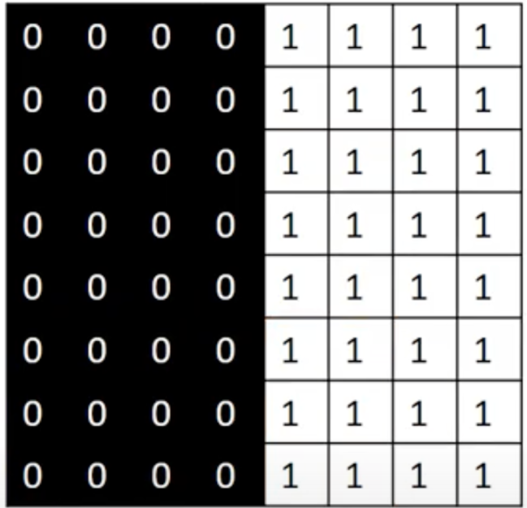



Convolution
Essentially element-wise (Hadamard) multiplications and summations(Dot product)
Input - A
Kernel - W
Here the stride is 1
Notes:
Intuition behind convolution, that there is an input image and a kernel which is convolved with the image( which I will just show in a bit how is it done) and creates an output mapp. Here this particular kernel basically is an edge detector. In image processing you can use these different kernels to get different features. Now how Neural Networks works is that they try to learn these kernel through backprop!

Slide 14

Convolution
Essentially element-wise (Hadamard) multiplications and summations
Stride = 1
Input - A
Kernel - W
Bias - B
A_{1,1}
A_{1,2}
A_{1,3}
A_{1,4}
A_{2,1}
A_{2,2}
A_{2,3}
A_{2,4}
W_{1,1}
W_{1,2}
A_{3,1}
A_{3,2}
A_{3,3}
A_{3,4}
W_{2,1}
W_{2,2}
B_{1,1}
Z_{1,1}
A_{4,1}
A_{4,2}
A_{4,3}
A_{4,4}
Z_{1,1} = (A_{1,1}*W_{1,1}) + (A_{1,2}*W_{1,2}) + (A_{2,1}*W_{2,1}) +(A_{2,2}*W_{2,2}) + B
Notes:
For NN these Kernels are like Weight matrix which are concolved with input values,,a dn bias is added to extract out certain feature of an image.

Slide 15
Convolution
Essentially element-wise (Hadamard) multiplications and summations
Stride = 1
A_{1,1}
A_{1,2}
A_{1,3}
A_{1,4}
A_{2,1}
A_{2,2}
A_{2,3}
A_{2,4}
W_{1,1}
W_{1,2}
B_{1,1}
Z_{1,1}
Z_{1,2}
A_{3,1}
A_{3,2}
A_{3,3}
A_{3,4}
W_{2,1}
W_{2,2}
A_{4,1}
A_{4,2}
A_{4,3}
A_{4,4}
Z_{1,2} = (A_{1,2}*W_{1,1}) + (A_{1,3}*W_{1,2}) + (A_{2,2}*W_{2,1}) + (A_{2,3}*W_{2,2}) + B

Slide 16
Convolution
Essentially element-wise (Hadamard) multiplications and summations
Stride = 1
A_{1,1}
A_{1,2}
A_{1,3}
A_{1,4}
A_{2,1}
A_{2,2}
A_{2,3}
A_{2,4}
W_{1,1}
W_{1,2}
B_{1,1}
Z_{1,1}
Z_{1,2}
Z_{1,3}
A_{3,1}
A_{3,2}
A_{3,3}
A_{3,4}
W_{2,1}
W_{2,2}
A_{4,1}
A_{4,2}
A_{4,3}
A_{4,4}
Z_{1,3} = (A_{1,3}*W_{1,1}) + (A_{1,4}*W_{1,2}) + (A_{2,3}*W_{2,1}) + (A_{2,4}*W_{2,2}) + B

Slide 17
Convolution
Essentially element-wise (Hadamard) multiplications and summations
Stride = 1
A_{1,1}
A_{1,2}
A_{1,3}
A_{1,4}
A_{2,1}
A_{2,2}
A_{2,3}
A_{2,4}
W_{1,1}
W_{1,2}
Z_{1,1}
Z_{1,2}
Z_{1,3}
B_{1,1}
A_{3,1}
A_{3,2}
A_{3,3}
A_{3,4}
W_{2,1}
W_{2,2}
Z_{2,1}
A_{4,1}
A_{4,2}
A_{4,3}
A_{4,4}

Slide 18
Convolution
Essentially element-wise (Hadamard) multiplications and summations
Stride = 1
A_{1,1}
A_{1,2}
A_{1,3}
A_{1,4}
Z_{1,1}
Z_{1,2}
Z_{1,3}
A_{2,1}
A_{2,2}
A_{2,3}
A_{2,4}
W_{1,1}
W_{1,2}
B_{1,1}
Z_{2,1}
Z_{2,2}
A_{3,1}
A_{3,2}
A_{3,3}
A_{3,4}
W_{2,1}
W_{2,2}
A_{4,1}
A_{4,2}
A_{4,3}
A_{4,4}

Slide 19
Convolution
Essentially element-wise (Hadamard) multiplications and summations
Stride = 1
A_{1,1}
A_{1,2}
A_{1,3}
A_{1,4}
Z_{1,1}
Z_{1,2}
Z_{1,3}
A_{2,1}
A_{2,2}
A_{2,3}
A_{2,4}
W_{1,1}
W_{1,2}
B_{1,1}
Z_{2,1}
Z_{2,2}
Z_{2,3}
A_{3,1}
A_{3,2}
A_{3,3}
A_{3,4}
W_{2,1}
W_{2,2}
A_{4,1}
A_{4,2}
A_{4,3}
A_{4,4}

Slide 20
Convolution
Essentially element-wise (Hadamard) multiplications and summations
Stride = 1
A_{1,1}
A_{1,2}
A_{1,3}
A_{1,4}
Z_{1,1}
Z_{1,2}
Z_{1,3}
A_{2,1}
A_{2,2}
A_{2,3}
A_{2,4}
W_{1,1}
W_{1,2}
B_{1,1}
Z_{2,1}
Z_{2,2}
Z_{2,3}
A_{3,1}
A_{3,2}
A_{3,3}
A_{3,4}
W_{2,1}
W_{2,2}
Z_{3,1}
A_{4,1}
A_{4,2}
A_{4,3}
A_{4,4}

Slide 21
Convolution
Essentially element-wise (Hadamard) multiplications and summations
Stride = 1
A_{1,1}
A_{1,2}
A_{1,3}
A_{1,4}
Z_{1,1}
Z_{1,2}
Z_{1,3}
A_{2,1}
A_{2,2}
A_{2,3}
A_{2,4}
W_{1,1}
W_{1,2}
B_{1,1}
Z_{2,1}
Z_{2,2}
Z_{2,3}
A_{3,1}
A_{3,2}
A_{3,3}
A_{3,4}
W_{2,1}
W_{2,2}
Z_{3,1}
Z_{3,2}
A_{4,1}
A_{4,2}
A_{4,3}
A_{4,4}

Slide 22
Convolution
Essentially element-wise (Hadamard) multiplications and summations
Stride = 1
A_{1,1}
A_{1,2}
A_{1,3}
A_{1,4}
Z_{1,1}
Z_{1,2}
Z_{1,3}
A_{2,1}
A_{2,2}
A_{2,3}
A_{2,4}
W_{1,1}
W_{1,2}
B_{1,1}
Z_{2,1}
Z_{2,2}
Z_{2,3}
A_{3,1}
A_{3,2}
A_{3,3}
A_{3,4}
W_{2,1}
W_{2,2}
Z_{3,1}
Z_{3,2}
Z_{3,3}
A_{4,1}
A_{4,2}
A_{4,3}
A_{4,4}

Slide 23
Output Size
A_{1,1}
A_{1,2}
A_{1,3}
A_{1,4}
Z_{1,1}
Z_{1,2}
Z_{1,3}
A_{2,1}
A_{2,2}
A_{2,3}
A_{2,4}
Z_{2,1}
Z_{2,2}
Z_{2,3}
A_{3,1}
A_{3,2}
A_{3,3}
A_{3,4}
Z_{3,1}
Z_{3,2}
Z_{3,3}
A_{4,1}
A_{4,2}
A_{4,3}
A_{4,4}

Slide 24
Output Size
A_{1,1}
A_{1,2}
A_{1,3}
A_{1,4}
Z_{1,1}
Z_{1,2}
Z_{1,3}
Output Width =
[(W_{in} - W_{k} + 2P) // (S)] + 1
Same goes for Height.
A_{2,1}
A_{2,2}
A_{2,3}
A_{2,4}
Z_{2,1}
Z_{2,2}
Z_{2,3}
A_{3,1}
A_{3,2}
A_{3,3}
A_{3,4}
Z_{3,1}
Z_{3,2}
Z_{3,3}
A_{4,1}
A_{4,2}
A_{4,3}
A_{4,4}

Slide 25
Output Size
A_{1,1}
A_{1,2}
A_{1,3}
A_{1,4}
Z_{1,1}
Z_{1,2}
Z_{1,3}
Output Width =
[(W_{in} - W_{k} + 2P) // (S)] + 1
P: Padding (here - 0)
S: Stride (here - 1)
A_{2,1}
A_{2,2}
A_{2,3}
A_{2,4}
Z_{2,1}
Z_{2,2}
Z_{2,3}
A_{3,1}
A_{3,2}
A_{3,3}
A_{3,4}
Z_{3,1}
Z_{3,2}
Z_{3,3}
A_{4,1}
A_{4,2}
A_{4,3}
A_{4,4}

Slide 26
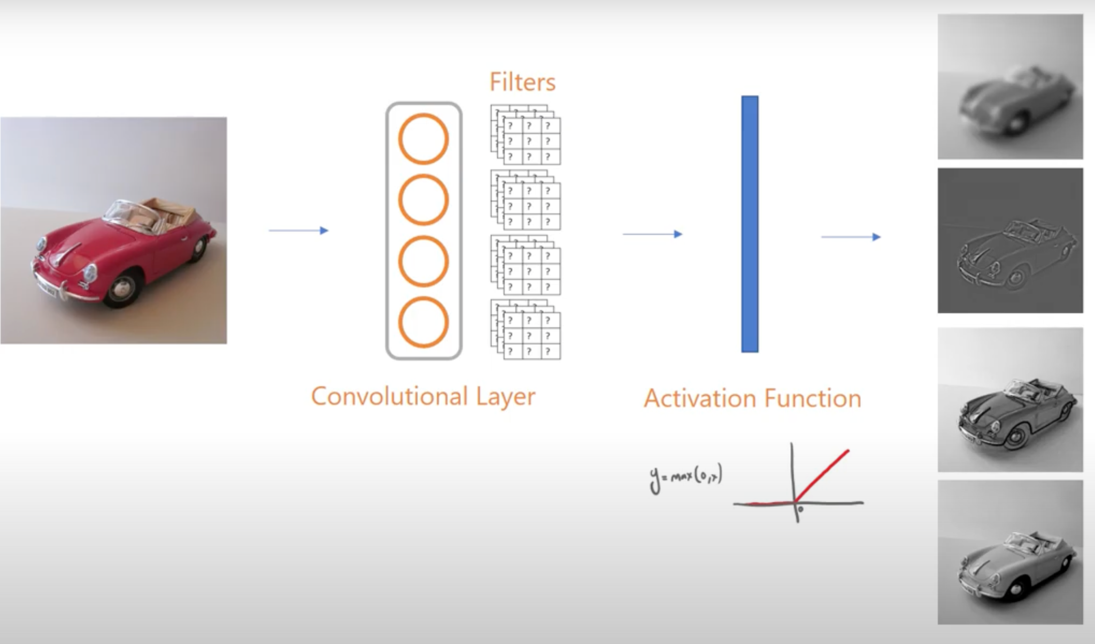
Convolution Neural Networks
Kernels
Output channels from Convolutional Layer
Convolution Layer
Activation Function
Notes:
A layer which consists of convolution units like is called convolution layer. Convolution Networks also known as CNNs basically use the convolution layers rather than using Linear Layers( as in MLP). The parameters learned in the each layer of the CNN can be thought of as the filters.
The output of these units is a filtered version of these inputs. Applying the activation function then, gives the output which focus on one of the features of the input. Prof will cover these things in greater detail in the lecture, here I just wanted to give u a complete view of what is conv, and what is CNN.

Slide 27
Stride = 1
What we did before - The kernel “moves” one pixel (or element) at a time.
A_{1,1}
A_{1,2}
A_{1,3}
A_{1,4}
Z_{1,1}
Z_{1,2}
Z_{1,3}
A_{2,1}
A_{2,2}
A_{2,3}
A_{2,4}
W_{1,1}
W_{1,2}
B_{1,1}
Z_{2,1}
Z_{2,2}
Z_{2,3}
A_{3,1}
A_{3,2}
A_{3,3}
A_{3,4}
W_{2,1}
W_{2,2}
Z_{3,1}
Z_{3,2}
Z_{3,3}
A_{4,1}
A_{4,2}
A_{4,3}
A_{4,4}

Slide 28
Stride = 2
Start at the same place
A_{1,1}
A_{1,2}
A_{1,3}
A_{1,4}
A_{2,1}
A_{2,2}
A_{2,3}
A_{2,4}
W_{1,1}
W_{1,2}
Z_{1,1}
B_{1,1}
A_{3,1}
A_{3,2}
A_{3,3}
A_{3,4}
W_{2,1}
W_{2,2}
A_{4,1}
A_{4,2}
A_{4,3}
A_{4,4}
Z_{1,1} = (A_{1,1}*W_{1,1}) + (A_{1,2}*W_{1,2}) + (A_{2,1}*W_{2,1}) + (A_{2,2}*W_{2,2}) + B

Slide 29
Stride = 2
Move two elements to the right
A_{1,1}
A_{1,2}
A_{1,3}
A_{1,4}
A_{2,1}
A_{2,2}
A_{2,3}
A_{2,4}
W_{1,1}
W_{1,2}
B_{1,1}
Z_{1,1}
Z_{1,2}
A_{3,1}
A_{3,2}
A_{3,3}
A_{3,4}
W_{2,1}
W_{2,2}
A_{4,1}
A_{4,2}
A_{4,3}
A_{4,4}
Z_{1,2} = (A_{1,3}*W_{1,1}) + (A_{1,4}*W_{1,2}) + (A_{2,3}*W_{2,1}) + (A_{2,4}*W_{2,2}) + B

Slide 30
Stride = 2
Move two elements down.
A_{1,1}
A_{1,2}
A_{1,3}
A_{1,4}
Z_{1,1}
Z_{1,2}
A_{2,1}
A_{2,2}
A_{2,3}
A_{2,4}
W_{1,1}
W_{1,2}
B_{1,1}
Z_{2,1}
A_{3,1}
A_{3,2}
A_{3,3}
A_{3,4}
W_{2,1}
W_{2,2}
A_{4,1}
A_{4,2}
A_{4,3}
A_{4,4}

Slide 31
Stride = 2
Move two elements to the right.
A_{1,1}
A_{1,2}
A_{1,3}
A_{1,4}
Z_{1,1}
Z_{1,2}
A_{2,1}
A_{2,2}
A_{2,3}
A_{2,4}
W_{1,1}
W_{1,2}
B_{1,1}
Z_{2,1}
Z_{2,2}
A_{3,1}
A_{3,2}
A_{3,3}
A_{3,4}
W_{2,1}
W_{2,2}
A_{4,1}
A_{4,2}
A_{4,3}
A_{4,4}
Notes:
You will learn how stride > 1 and stride < related to upsampling and downsampling in HW1

Slide 32
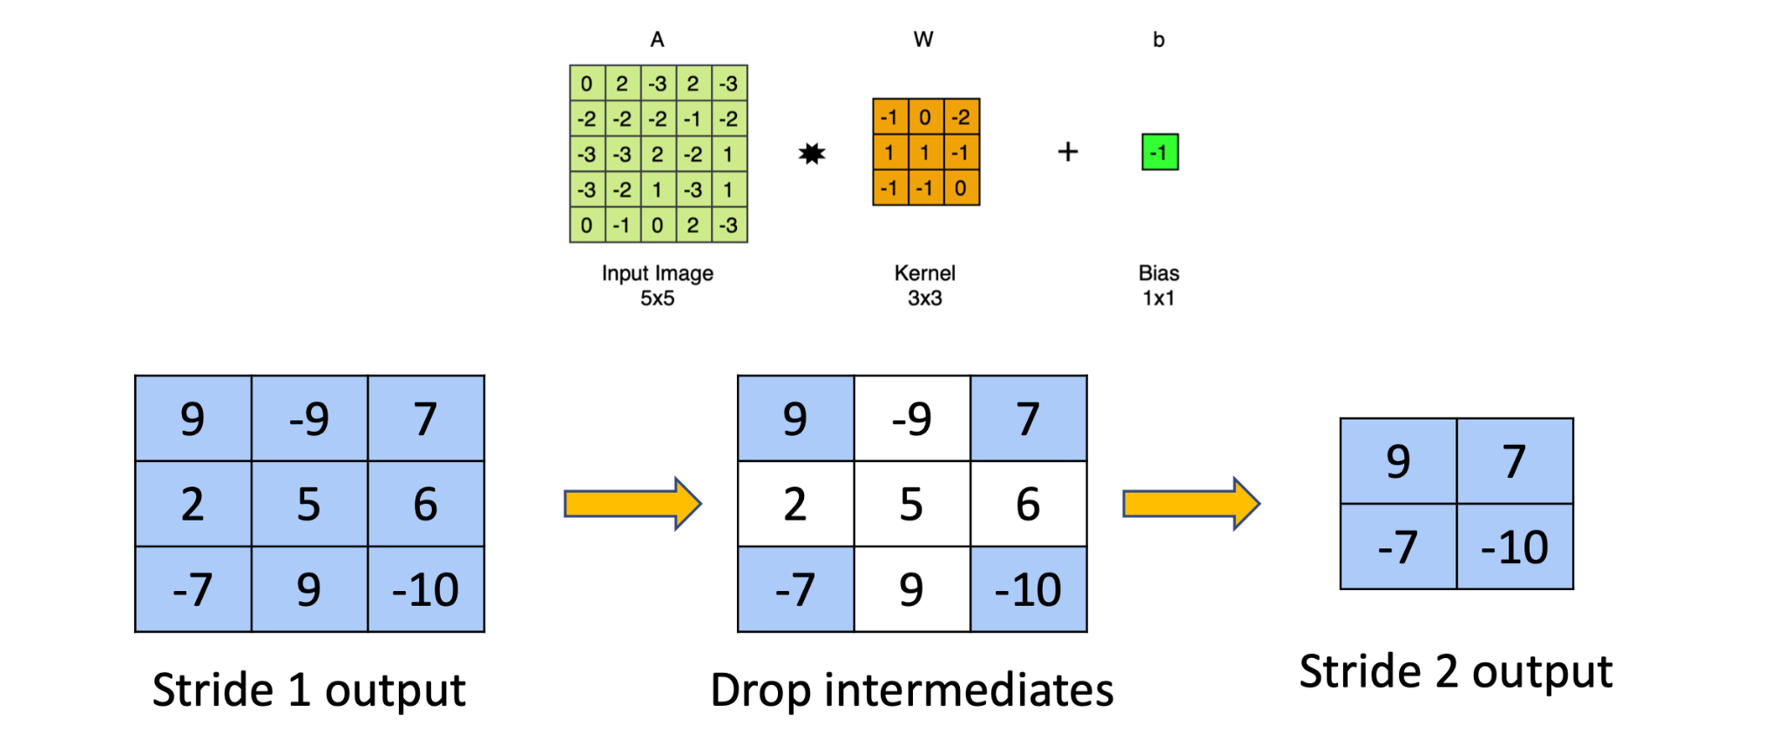
Interpreting Stride > 1
Think about how it is related to Upsampling( and Downsampling.
Will learn more in HW2
Notes:
WHy Stride:
Updample/downsample the image
Reduce the size of feature maps
Remove redundant features in neighboorhood

Slide 33
Padding
A_{1,1}
A_{1,2}
A_{1,3}
A_{1,4}
A_{2,1}
A_{2,2}
A_{2,3}
A_{2,4}
W_{1,1}
W_{1,2}
B_{1,1}
Z_{1,1}
A_{3,1}
A_{3,2}
A_{3,3}
A_{3,4}
W_{2,1}
W_{2,2}
A_{4,1}
A_{4,2}
A_{4,3}
A_{4,4}
A_{1,1}
A_{1,2}
A_{1,3}
A_{1,4}
Z_{1,1}
Z_{1,2}
Z_{1,3}
A_{2,1}
A_{2,2}
A_{2,3}
A_{2,4}
W_{1,1}
W_{1,2}
B_{1,1}
Z_{2,1}
Z_{2,2}
Z_{2,3}
A_{3,1}
A_{3,2}
A_{3,3}
A_{3,4}
W_{2,1}
W_{2,2}
Z_{3,1}
Z_{3,2}
Z_{3,3}
A_{4,1}
A_{4,2}
A_{4,3}
A_{4,4}

Slide 34
Padding
Increase output size
Preserve input size
More Kernel Interactions!
Notes:
But be catious ith the amount of padding you do, since sometimes the whole point of CNN is to reduce the size of the feature maps.

Slide 35
Padding
Padding = 1
0
0
0
0
0
0
0
A_{1,1}
A_{1,2}
A_{1,3}
A_{1,4}
0
Z_{1,1}
Z_{1,2}
Z_{1,3}
Z_{1,4}
0
A_{2,1}
A_{2,2}
A_{2,3}
A_{2,4}
0
W_{1,1}
W_{1,2}
Z_{2,1}
Z_{2,2}
Z_{2,3}
Z_{2,4}
B_{1,1}
0
A_{3,1}
A_{3,2}
A_{3,3}
A_{3,4}
0
W_{2,1}
W_{2,2}
Z_{3,1}
Z_{3,2}
Z_{3,3}
Z_{3,4}
0
A_{4,1}
A_{4,2}
A_{4,3}
A_{4,4}
0
Z_{4,1}
Z_{4,2}
Z_{4,3}
Z_{4,4}
A_{4,1}
A_{4,1}
A_{4,2}
A_{4,3}
A_{4,4}
A_{4,4}
0
0
0
0
0
0
Notes:
What if there is a mismatch between kernel size and allowable dimension of input (width and height), the kernel cannot ”fall-off”. We need to accommodate the kernel and hence we pad the input.

Slide 36
Padding
Padding = 1
0
0
0
0
0
0
0
A_{1,1}
A_{1,2}
A_{1,3}
A_{1,4}
0
Z_{1,1}
Z_{1,2}
Z_{1,3}
Z_{1,4}
0
A_{2,1}
A_{2,2}
A_{2,3}
A_{2,4}
0
W_{1,1}
W_{1,2}
Z_{2,1}
Z_{2,2}
Z_{2,3}
Z_{2,4}
B_{1,1}
0
A_{3,1}
A_{3,2}
A_{3,3}
A_{3,4}
0
W_{2,1}
W_{2,2}
Z_{3,1}
Z_{3,2}
Z_{3,3}
Z_{3,4}
0
A_{4,1}
A_{4,2}
A_{4,3}
A_{4,4}
0
Z_{4,1}
Z_{4,2}
Z_{4,3}
Z_{4,4}
A_{4,1}
A_{4,1}
A_{4,2}
A_{4,3}
A_{4,4}
A_{4,4}
0
0
0
0
0
0

Slide 37
Padding
0
0
0
0
0
0
0
A_{1,1}
A_{1,2}
A_{1,3}
A_{1,4}
0
Z_{1,1}
Z_{1,2}
Z_{1,3}
Z_{1,4}
0
A_{2,1}
A_{2,2}
A_{2,3}
A_{2,4}
0
W_{1,1}
W_{1,2}
Z_{2,1}
Z_{2,2}
Z_{2,3}
Z_{2,4}
B_{1,1}
0
A_{3,1}
A_{3,2}
A_{3,3}
A_{3,4}
0
W_{2,1}
W_{2,2}
Z_{3,1}
Z_{3,2}
Z_{3,3}
Z_{3,4}
0
A_{4,1}
A_{4,2}
A_{4,3}
A_{4,4}
0
Z_{4,1}
Z_{4,2}
Z_{4,3}
Z_{4,4}
A_{4,1}
A_{4,1}
A_{4,2}
A_{4,3}
A_{4,4}
A_{4,4}
0
0
0
0
0
0

Slide 38
Multi-channel CNN
Input channels
CNN/Conv layer
Output channels
???

Slide 39
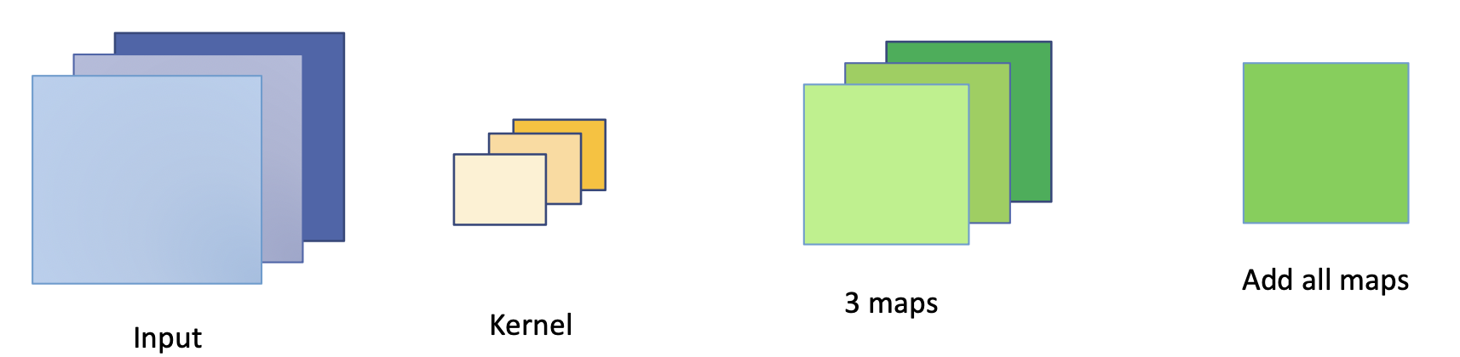
Multi-channel CNN
Each kernel (or filter) has as many channels as the input does.
[kernel channels = Input channels]
Channel c of the kernel convolves with channel c (corresponding) of the input.
The number of output channels from the convolution = number of filters(kernels) applied to the input.
Notes:
All the output maps produced by all the different channels get combine into one output map per filter

Slide 40
1 Filter with 3-channel input
W_{1,1}
W_{1,2}
W_{1,1}
W_{1,2}
W_{B,1,1}
W_{B,1,2}
Z_{1,1}
Z_{1,2}
Z_{1,3}
Z_{1,1}
Z_{1,2}
Z_{1,3}
Z_{1,1}
Z_{1,2}
Z_{1,3}
Z_{B,1,1}
Z_{B,1,2}
Add
through
channels
W_{2,1}
W_{2,2}
Z_{B,1,3}
W_{2,1}
W_{2,2}
W_{B,2,1}
W_{B,2,2}
Z_{2,1}
Z_{2,2}
Z_{2,3}
⊗
=
Z_{2,1}
Z_{2,2}
Z_{2,3}
Z_{2,1}
Z_{2,2}
Z_{2,3}
Z_{B,2,1}
Z_{B,2,2}
Z_{B,2,3}
Z_{3,1}
Z_{3,2}
Z_{3,3}
Z_{3,1}
Z_{3,2}
Z_{3,3}
Z_{3,1}
Z_{3,2}
Z_{3,3}
B_{1,1}
Z_{B,3,1}
Z_{B,3,2}
Z_{B,3,3}
B_{1,1}
B_{B,1,1}
3 channel input
Kernel/filter
3 almost-output maps
1 output map
Notes:
We had 3 input channels, our 1 kernel had 3 channels, which correspondingly convolve with the channel of the input which produces 3 output maps which are added element by element to create the output map

Slide 41
2 Filters with 3-channel input
W_{1,1}
W_{1,2}
W_{1,1}
W_{1,2}
B_{1,1}
W_{1,B,1,1}
W_{1,B,1,2}
B_{1,1}
Z_{1,2,2}
B_{1,B,1,1}
W_{2,1}
W_{2,2}
W_{2,1}
W_{2,2}
W_{1,B,2,1}
W_{1,B,2,2}
⊗
W_{1,1}
W_{1,2}
W_{1,1}
W_{1,2}
B_{1,1}
W_{B,1,1}
W_{2,B,1,1}
W_{B,1,2}
W_{2,B,1,2}
B_{1,1}
B_{2,B,1,1}
W_{2,1}
W_{2,2}
Z_{2,2,2}
W_{2,1}
W_{2,2}
W_{B,2,1}
W_{2,B,2,1}
W_{B,2,2}
W_{2,B,2,2}
3 channel input
2 Kernels
2 output maps
Notes:
Now here no of kernels defines the number of output maps or number of output channels you will get.

Slide 42
Pooling Layer
A pooling layer in a Convolutional Neural Network (CNN) is a fundamental component used to downsample the spatial dimensions of the feature maps produced by convolutional layers. Pooling layers are responsible for reducing the size of the feature maps while retaining the most important information.
Max-pooling and average-pooling are common pooling operations.
Introduces Jitter Invariance
Reduces memory footprint by reducing the feature-map size

Slide 43
Pooling
4
8
3
9
16
10
0
7
2x2 Max Pool
Stride = 2
16
9
6
12
13
8
67
13
67
18
3
7
Notes:
If you look at one box, even if pixel values changes by few points here and there, we are not able to transfer data properly, we missed out on some pixel intensities , even so the maximum won’t change as often, It will introduce some sort of resilience in your network

Slide 44
Pooling
4
8
3
9
2x2 Mean/average Pool
Stride = 2
16
10
0
7
9.5
4.75
6
12
13
8
25.75
7.75
67
18
3
7

Slide 45
Backpropagation in CNN

Slide 46
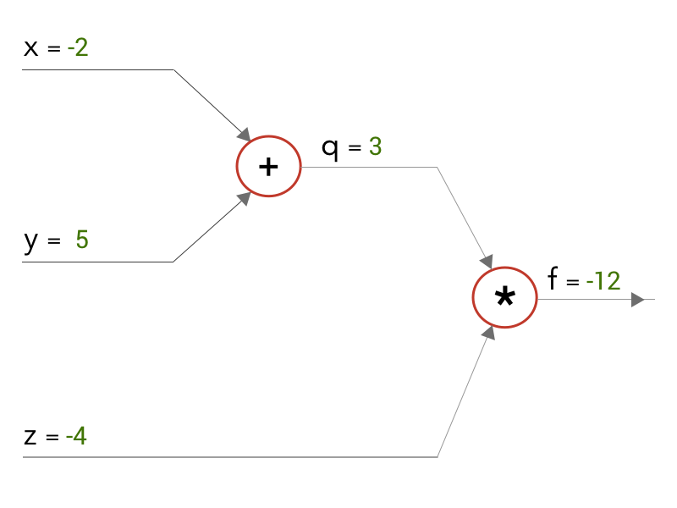
Backpropagation: Chain Rule Refresher
All visual credits to: https://pavisj.medium.com/convolutions-and-backpropagations-46026a8f5d2c
Notes:
Before we move on to the backpropagation with CNN, let’s have a little refresher on chain rule as backpropagation is all about derivation.
When we solve for the equations, we move from left to right, (‘the forward pass’).
Consider this simple computation graph – after forward pass, we get an output of f = -12

Slide 47
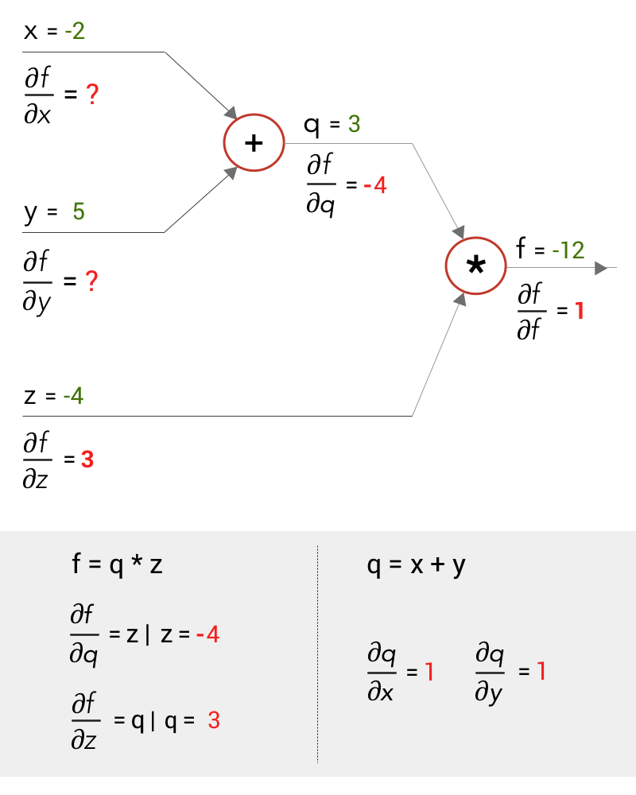
Backpropagation: Chain Rule Refresher
Notes:
Now let us do the backward pass. Say, just like in Backpropagations, we derive the gradients moving from right to left at each stage. So, at the end, we have to get the values of the gradients of our inputs x,y and z — ∂f/∂x and ∂f/∂y and ∂f/∂z (differentiating function f in terms of x,y and z)
Working from right to left, at the multiply gate we can differentiate f to get the gradients at q and z — ∂f/∂q and ∂f/∂z . And at the add gate, we can differentiate q to get the gradients at x and y — ∂q/∂x and ∂q/∂y.

Slide 48
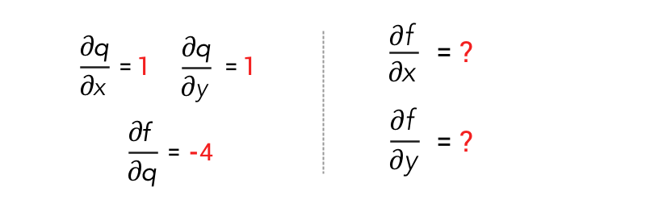
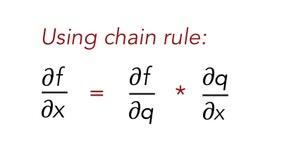
Backpropagation: Chain Rule Refresher
Notes:
We have to find ∂f/∂x and ∂f/∂y but we only have got the values of ∂q/∂x and ∂q/∂y. So, how do we go about it?
This can be done using the chain rule of differentiation. By the chain rule, we can find ∂f/∂x as this equation down below.

Slide 49
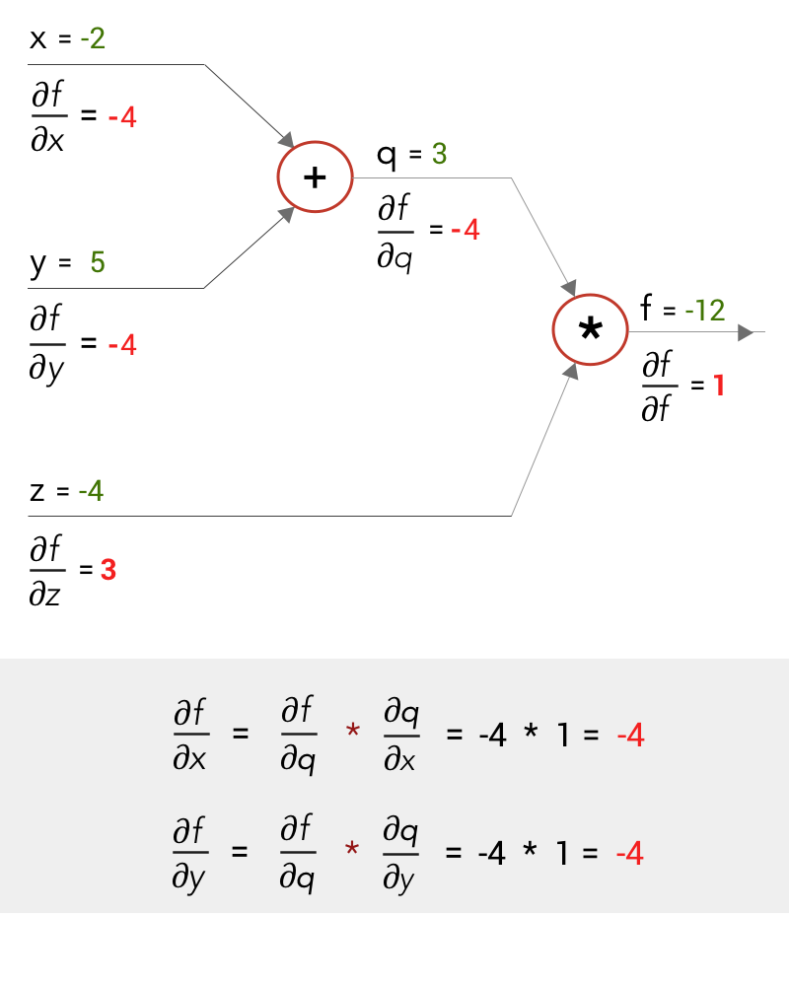
Backpropagation: Chain Rule Refresher
Notes:
so we can find the values that we want like this

Slide 50
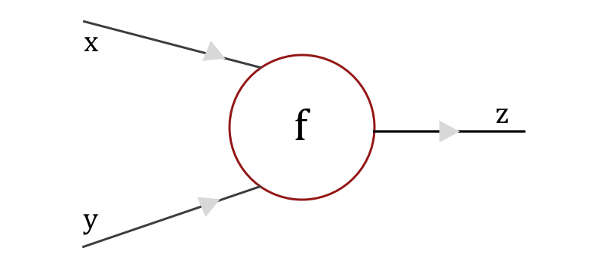
Backpropagation: Chain Rule in Convolutional Layer
Notes:
Now imagine a CNN as a massive computational graph. Let us say we have a gate f in that computational graph with inputs x and y which outputs z.

Slide 51
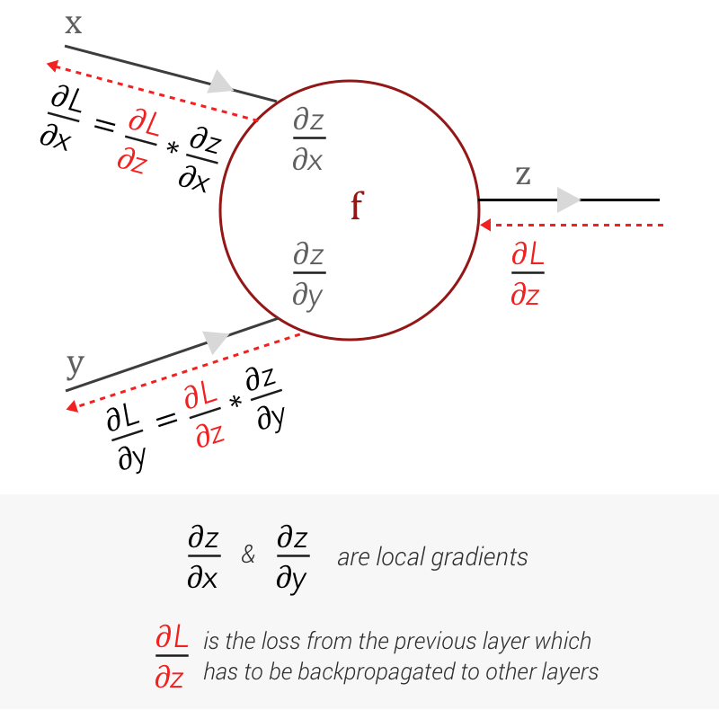
Backpropagation: Chain Rule in Convolutional Layer
Notes:
Just like the simple example we just saw, we can easily compute the local gradients — differentiating z with respect to x and y as ∂z/∂x and ∂z/∂y
For the forward pass, we move across the CNN, moving through its layers and at the end obtain the loss, using the loss function. And when we start to work the loss backwards, layer across layer, we get the gradient of the loss from the previous layer as ∂L/∂z. In order for the loss to be propagated to the other gates, we need to find ∂L/∂x and ∂L/∂y.

Slide 52
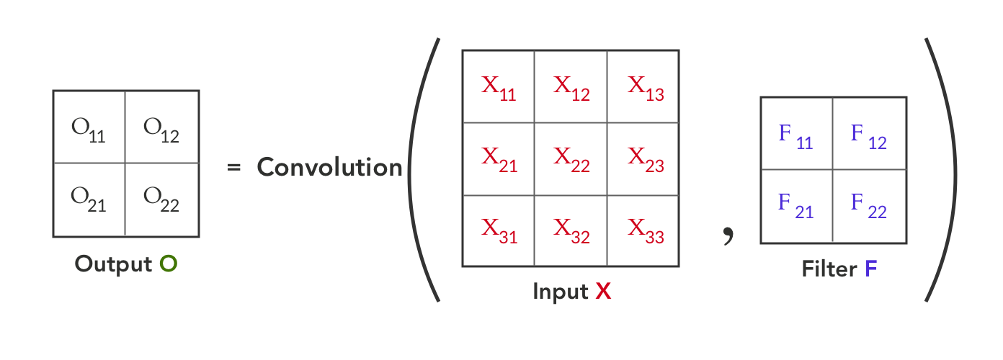
Backpropagation: Chain Rule in Convolutional Layer
Notes:
Now, lets assume the function f is a convolution between Input X and a Filter F. Input X is a 3x3 matrix and Filter F is a 2x2 matrix, as shown here:
Convolution between Input X and Filter F, gives us an output O.

Slide 53
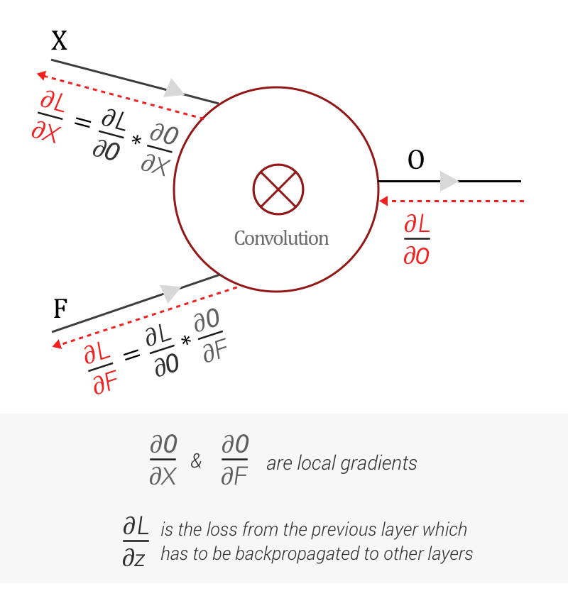
Backpropagation: Chain Rule in Convolutional Layer
*This slide contains an animation, so it might not show up in the pdf file
Notes:
You can see the forward pass here, filter sliding through input X to give you the convolution output. Now coming back to the back propagation, as mentioned earlier, we get the loss gradient with respect to the Output O from the next layer as ∂L/∂O, during Backward pass. And combining with our previous knowledge using Chain rule and Backpropagation we get this computational graph.
We can find the local gradients ∂O/∂X and ∂O/∂F with respect to Output O. And with loss gradient from previous layers — ∂L/∂O and using chain rule, we can calculate ∂L/∂X and ∂L/∂F respectively.

Slide 54
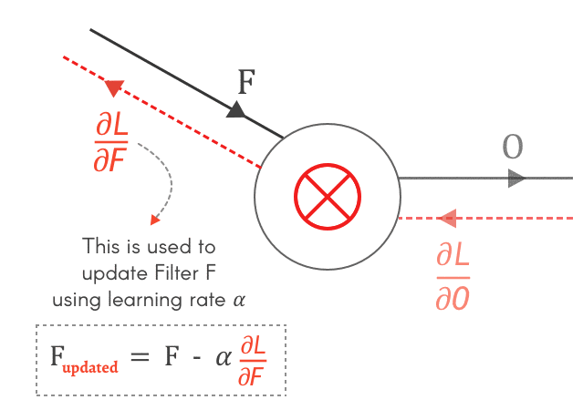
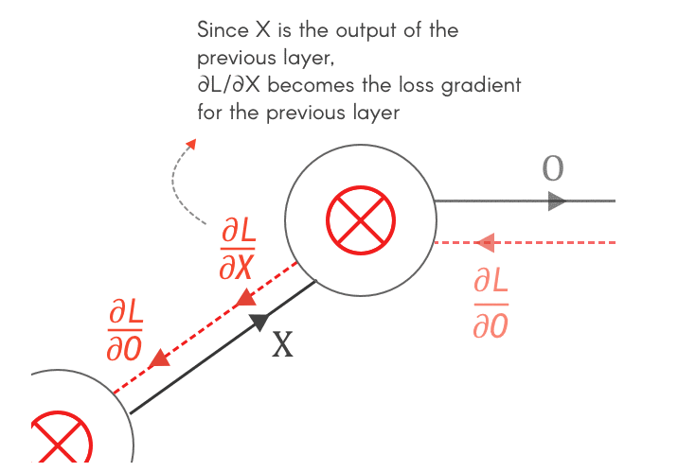
Backpropagation: Finding Gradients for X and F
Notes:
So why do we need to calculate ∂L/∂X and ∂L/∂F — it’s because dL/dF is used to update the filter F using the learning rate alpha, and dLdX is the loss gradient from the previous layer.

Slide 55
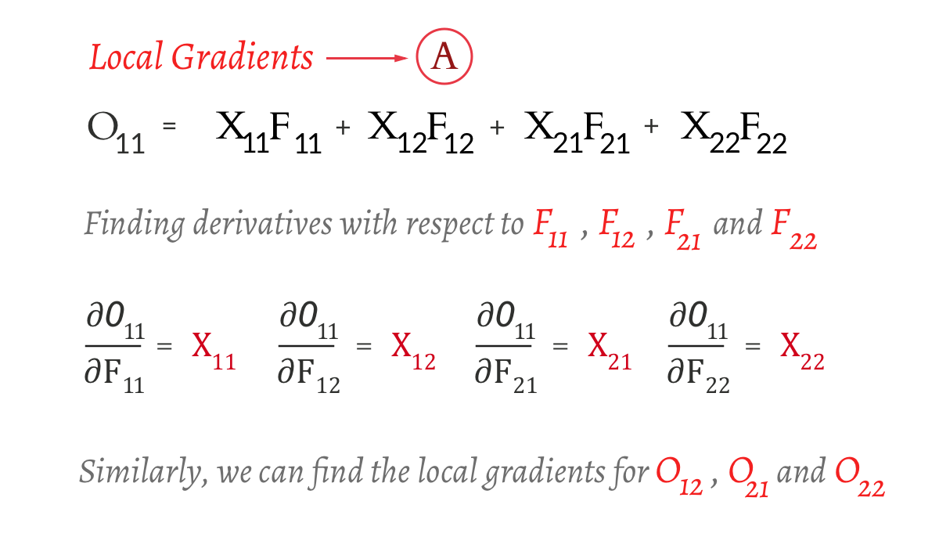
Backpropagation: Finding ∂L/∂F
Step 1: Finding the local gradient - ∂O/∂F
Notes:
Now let’s start with finding the dL/dF. We will start off by finding the local gradient dO/dF, meaning we have to differentiate Output Matrix O with Filter F. From our convolution operation, we know the values. So let us start differentiating the first element of O- O¹¹ with respect to the elements of F — F¹¹ , F¹², F²¹ and F²² (Draw on chalk board)

Slide 56
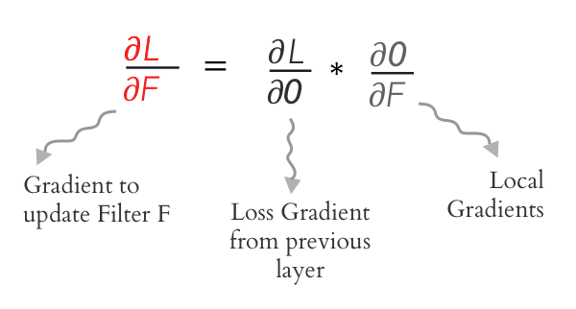
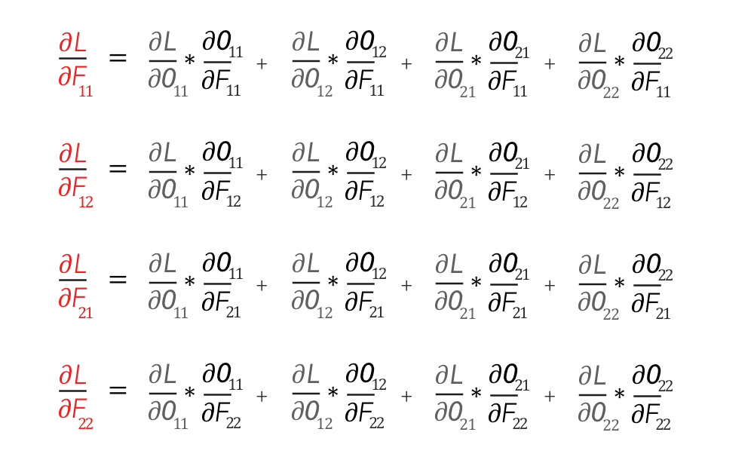
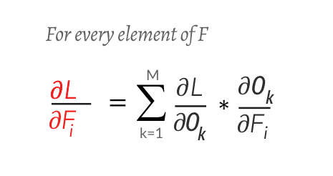
Backpropagation: Finding ∂L/∂F
Step 2: Using the Chain rule
Notes:
O and F are matrices. And ∂O/∂F will be a partial derivative of a matrix O with respect to a matrix F! On top of it we have to use the chain rule. This does look complicated but thankfully we can use the formula down below to expand it.

Slide 57
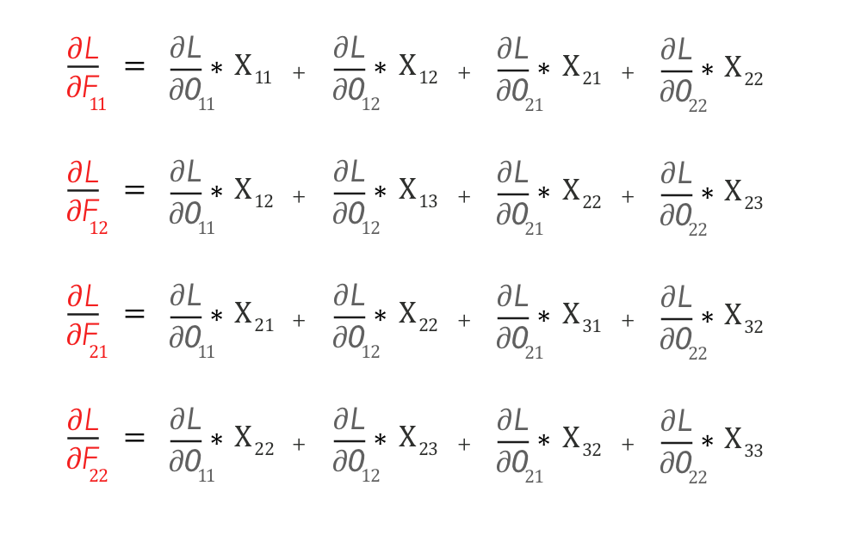
Backpropagation: Finding ∂L/∂F
Step 2: Using the Chain rule
Notes:
Substituting the values of the local gradient — ∂O/∂F from the previous slides, we get much simpler expression like this

Slide 58
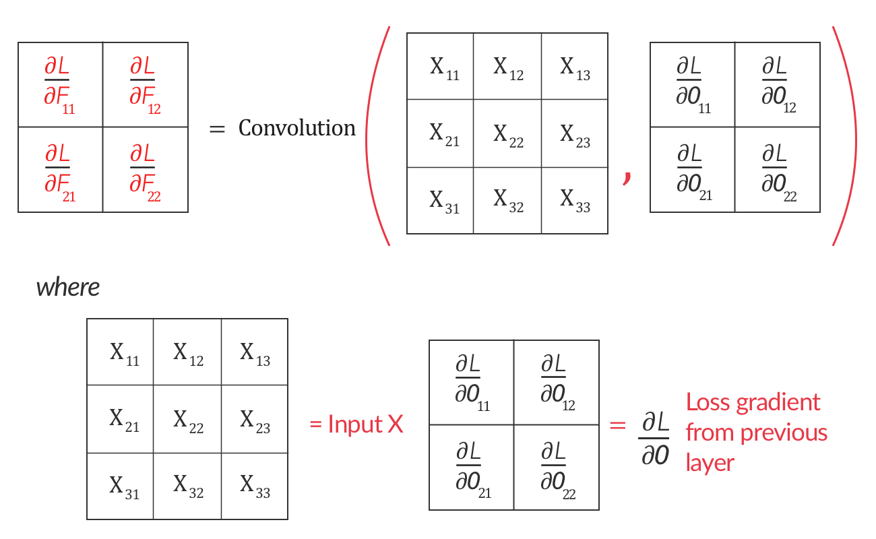
Backpropagation: Finding ∂L/∂F
∂L/∂F is nothing but the convolution between Input X and Loss Gradient from the next layer ∂L/∂O
Notes:
Now if you closely look at it, this represents an operation we are quite familiar with – a convolution operation between input X and loss gradient ∂L/∂O just like shown here. So we’re done with dL/dF here.

Slide 59
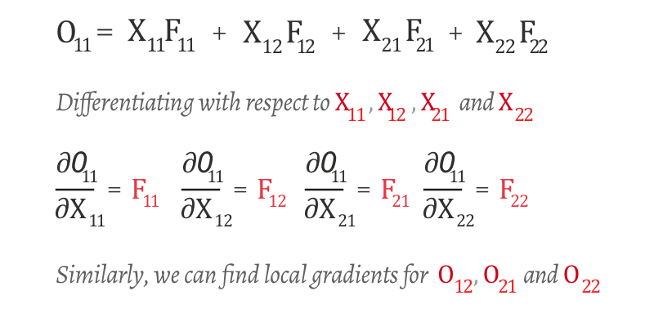
Backpropagation: Finding ∂L/∂O
Step 1: Finding the local gradient - ∂O/∂X
Notes:
Moving on to dL/dO, similar to how we found the local gradients earlier, we can find ∂O/∂X like this. Simple.

Slide 60
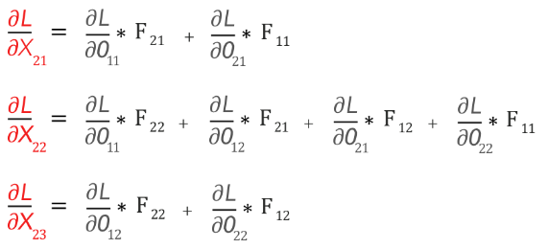
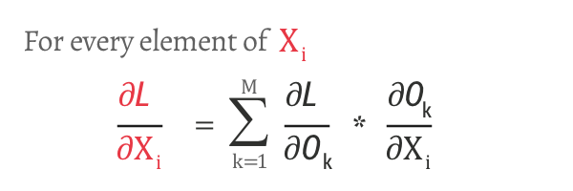
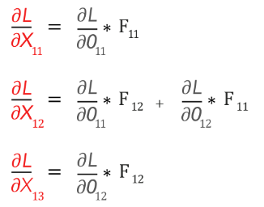
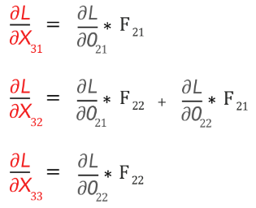
Backpropagation:
Finding ∂L/∂O
Step 2: Using the Chain rule
Notes:
Following our convention, we will use chain rule to find dL/dX. Looks nasty, but let me break it down for you here (draw)

Slide 61
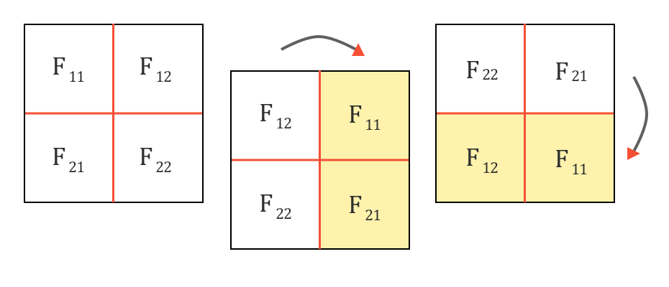
Backpropagation:
∂L/∂X as a ‘Full Convolution’
Step 1: Rotate the Filter F by 180 degrees - flipping it first vertically and then horizontally
Notes:
Now believe it or not, even this can also be represented as a convolution operation.
∂L/∂X can be represented as ‘full’ convolution between a 180-degree rotated Filter F and loss gradient ∂L/∂O
First, let us rotate the Filter F by 180 degrees. This is done by flipping it first vertically and then horizontally.

Slide 62
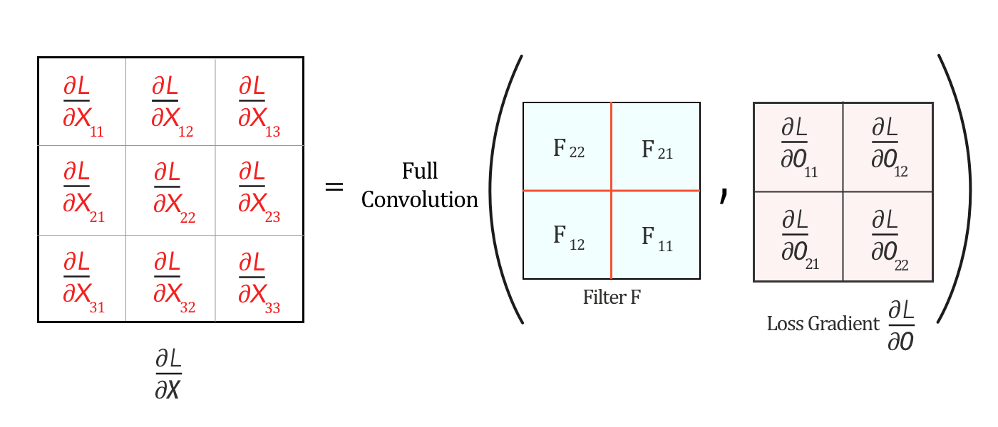
Backpropagation:
∂L/∂X as a ‘Full Convolution’
*This slide contains an animation, so it might not show up in the pdf file
Step 2: Full convolution between flipped filter F and ∂L/∂O
Notes:
Now, if we perform a ‘full’ convolution between this flipped Filter F and ∂L/∂O, by like sliding one matrix over another from right to left, bottom to top, it generates the values of ∂L/∂X just like how we discussed on the board.

Slide 63
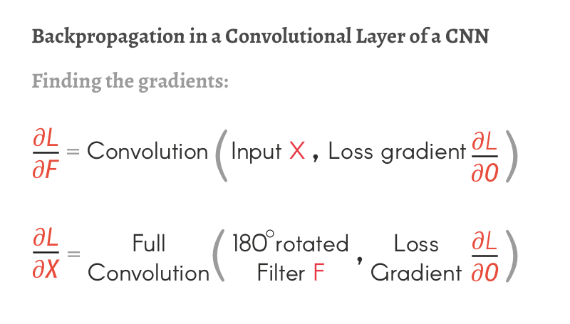
Backpropagation: Conclusion
Notes:
To sum up, backpropagation in convolution can be explained using the idea of convolution again. dLdF is the convolution between input X and loss gradient dL/dO, a loss gradient with respect to the Output O from the next layer, and dLdX is the full convolution between flipped filter F and again, dLdO. You just have to perform this operation from right to left, until you reach to the end (or the very first layer)

